Slide 1
Flow Control
TCP

Slide 2
TCP
TCP lies between the application layer and the network layer, and serves as the intermediary between the application programs and the network operations.
Process to process communication

Slide 3
Introduction
TCP provides a
connection oriented
reliable
byte stream service
The term connection oriented means the two application using TCP must establish a TCP Connection with each other before exchange data.

Slide 4
TCP services
There are exactly two end points communication with each other on TCP connection.
Does not support multicasting and broad casting .
Unit of information passed by TCP to IP is called a segment.
When TCP sends a segment it maintains a timer ,waiting for the other end to acknowledge.

Slide 5
TCP Service cont ..
If an acknowledgement isn’t received in time ,the segment is retransmitted .
TCP also provides flow control
A TCP connection is a byte stream not a message stream .

Slide 6
TCP Features
Numbering System:
The TCP software keeps track of the segments being transmitted or received.
There are two fields called the sequence number and the acknowledgment number.
Full-Duplex Communication
TCP offers full-duplex service, in which data can flow in both directions at the same time.
Each TCP then has a sending and receiving buffer, and segments move in both directions.

Slide 7
Flow Control
The receiver of the data controls the amount of data that are to be sent by the sender. This is done to prevent the receiver from being overwhelmed with data.
Error Control
To provide reliable service, TCP implements an error control mechanism.
Congestion Control
The amount of data sent by a sender is not only controlled by the receiver, but by the level of congestion in the network.

Slide 8
Flow Control
Flow control is a technique whose primary purpose is to properly match transmission rate of sender to that of the receiver and the network.
It should protect against overwhelming the network or receiver host .
TCP uses a sliding window, to handle flow control.
something between the Go-Back-N and Selective Repeat sliding window.
TCP uses the window field as the primary means for flow control.
During the data transfer phase, the window field is used to adjust the rate of flow of the byte stream between communicating TCPs.

Slide 9

In TCP, the receiver specifies the current Window size in every packet.
Initial window sizes are indicated at connection setup, but might vary through out the data transfer to provide flow control.
A window size of zero, means send no data
Note
A sliding window is used to make transmission more efficient as well as to control the flow of data so that the destination does not become
overwhelmed with data.
TCP sliding windows are byte-oriented.

Slide 10
Go-Back-N protocol: it does not use NAKs;
Selective Repeat: the receiver holds the out-of-order segments until the missing ones arrive
Two big differences
the sliding window of TCP is byte-oriented, data link layer is frame-oriented
TCP's sliding window is of variable size; data link layer was of fixed size

Slide 11

Figure 23.22 Sliding window
The window spans a portion of the buffer containing bytes received from the process.
The bytes inside the window are the bytes that can be in transit; they can be sent without worrying about acknowledgment.
The imaginary window has two walls: one left and one right.

Slide 12

The window is
    opened,
    closed, or shrunk.
These three activities, are in the control of the receiver (and depend on congestion in the network), not the sender.
The sender must obey the commands of the receiver in this matter.
Opening a window means moving the right wall to the right. This allows more new bytes in the buffer that are eligible for sending
Closing the window means moving the left wall to the right. This means that some bytes have been acknowledged and the sender
Shrinking the window means moving the right wall to the left. means revoking the eligibility of some bytes for sending

Slide 13
The size of the window at one end is determined by the lesser of two values:
  Receiver window (rwnd) or
  congestion window (cwnd).
receiver window is the value advertised by the opposite end in a segment containing acknowledgment.
It is the number of bytes the other end can accept before its buffer overflows and data are discarded.
congestion window is a value determined by the network to avoid congestion

Slide 14
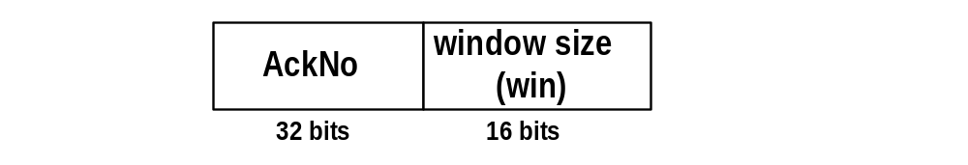
Window Management in TCP
The receiver is returning two parameters to the sender

Slide 15
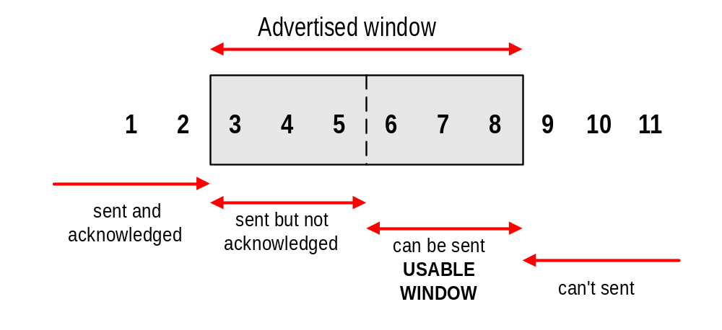
Sliding Window Flow Control
Sliding Window Protocol is performed at the byte level:
Here: Sender can transmit sequence numbers 6,7,8.

Slide 16
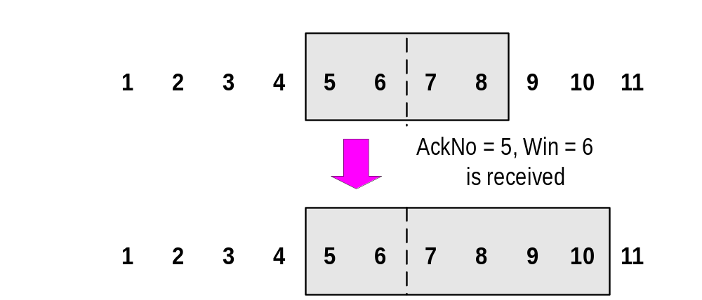
Sliding Window: “Window Opens”
Acknowledgement is received that enlarges the window to the right (AckNo = 5, Win=6):
A receiver opens a window when TCP buffer empties (meaning that data is delivered to the application).

Slide 17
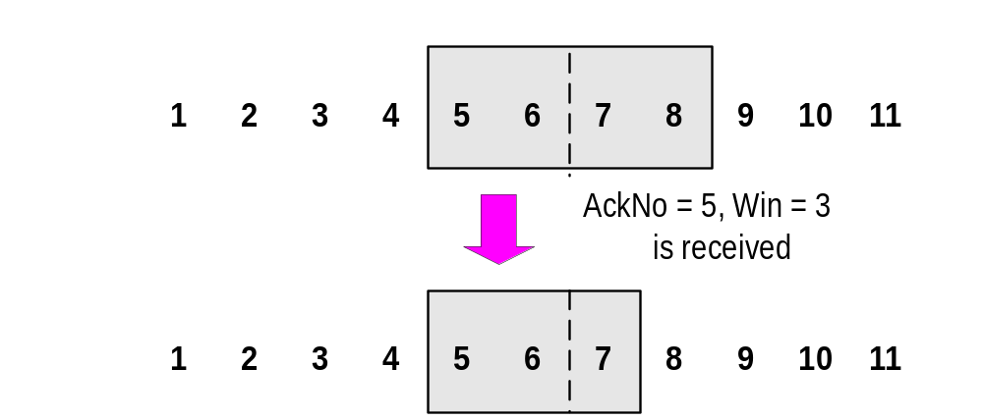
Sliding Window: “Window Shrinks”
Acknowledgement is received that reduces the window from the right (AckNo = 5, Win=3):
Shrinking a window should not be used

Slide 18
